Slide 1
Active Folder : Integrating All Activities of Simulation on File System
Suntae Hwang ( sthwang@kookmin.ac.kr )
Daeyoung Heo ( dyheo@kookmin.ac.kr )
School of Computer Science
Kookmin University
Apr 10 2014

Slide 2


Active Folder: Integrating All Activities of Simulation on File System
Active Folder – good for case comparative study
Tasks
Described as regular folders and files
Products
Input or output of simulation
Can be handled like regular file by using legacy software
Contains provenance information (meta data, task info, etc)
Can be reproduced by the task which is extracted from the provenance information
Apps(Computing Resource)
Computing server(Local, Grid, Cloud, what ever, …) is registered as regular folders and files
To submit a Job(task), just Drag&Drop the task folder to the folder which represents computing server
ActiveFolder

Slide 3

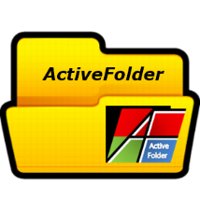

Active Folder: Integrating All Activities of Simulation on File System
Producing
Analizing
Storage
(Cloud, Local, ..)
Sharing
Products
Tasks
Apps
Computing
(Cloud, Grid, Local, …)
Or Searching(DB, IR, …)
User’s own environment

Slide 4

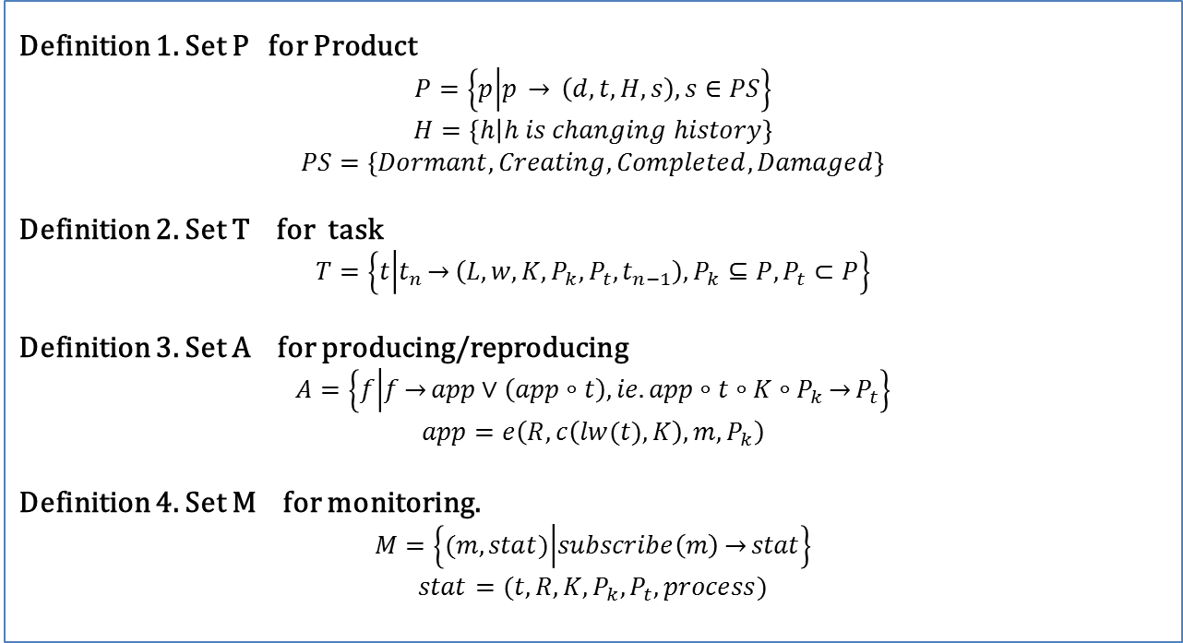
Formal Definition of Spaces in Active Folder
Definition 1. Set P for Product
$$P=\left\{p | p \overset{→}{} \left(d,t,H,s\right), s∈PS\right\}$$
$$H=\left\{h | h is changing history\right\}$$
$$PS=\left\{Dormant, Creating, Completed, Damaged\right\}$$
Definition 2. Set T for task
$$T=\left\{t | t_{n}\overset{→}{}\left(L,w,K,P_{k},P_{t},t_{n−1}\right),P_{k}⊆P,P_{t}⊂P\right\}$$
Definition 3. Set A for producing/reproducing
$$A=\left\{f | f\overset{→}{}app∨\left(app∘t\right), ie.app∘t∘K∘P_{k}\overset{→}{}P_{t}\right\}$$
$$app=e\left(R,c\left(lw(t),K\right),m,P_{k}\right)$$
Definition 4. Set M for monitoring.
$$M=\left\{(m,stat) | subscribe\left(m\right)\overset{→}{}stat\right\}$$
$$stat=(t,R,K,P_{k},P_{t},process)$$

Slide 5
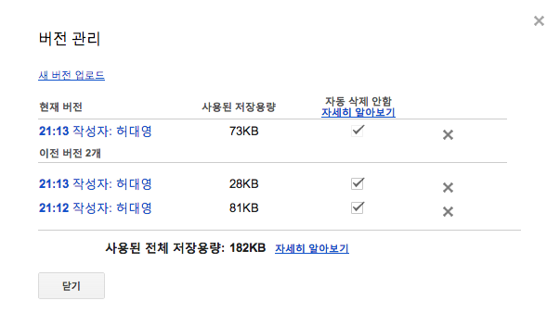
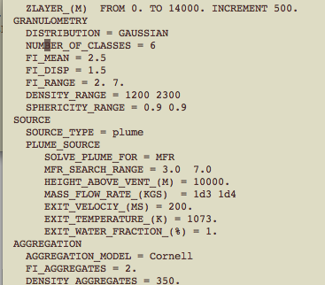
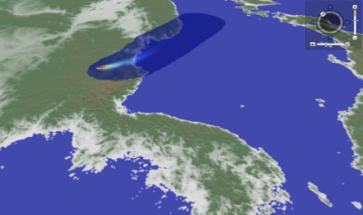
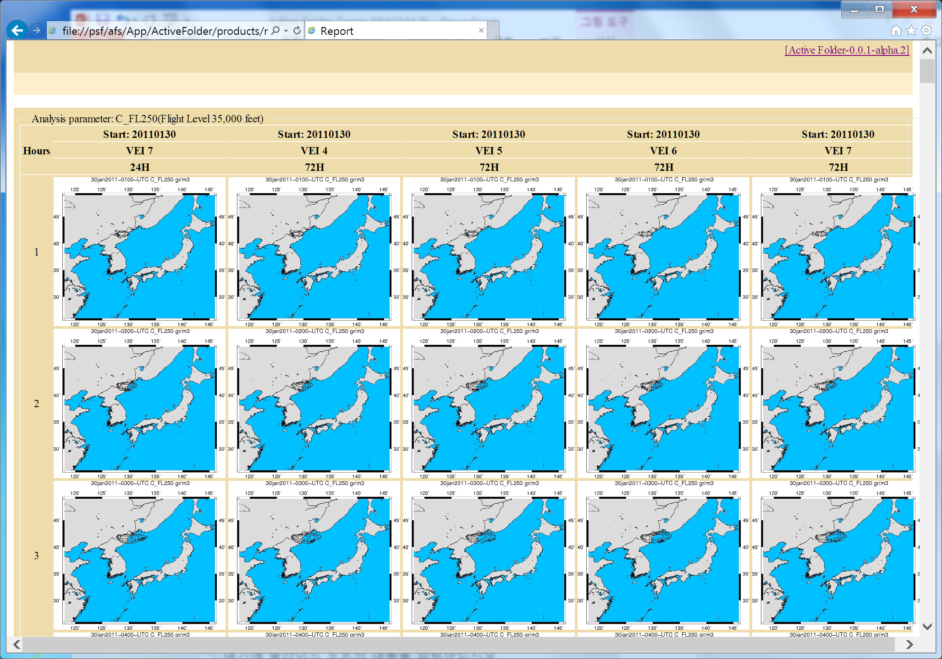
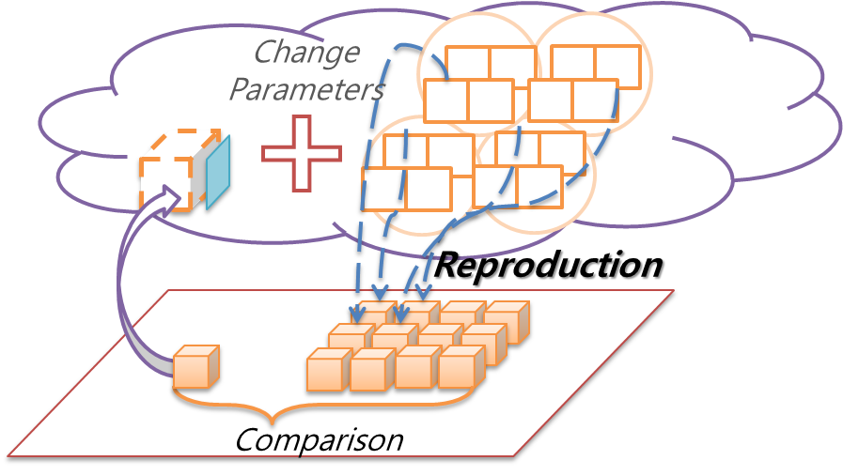
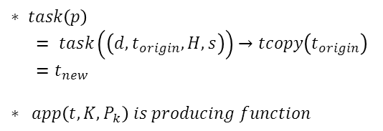
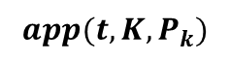
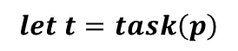
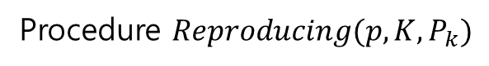
Active Folder: Product and Reproducing
Product consists of data, history info and task(provenance)
Product
History
DATA
Task
Visualize & Analysis
Task can be extracted from products and used for producing similar results with different parameters
Fall3D
Procedure $Reproducing(p,K,P_{k})$
$$let t=task\left(p\right)$$
Different
parameters
$$app(t,K,P_{k})$$
$$∗ task\left(p\right)$$
$= task\left(\left(d,t_{origin},H,s\right)\right)→tcopy\left(t_{origin}\right)$
$=t_{new}$
$$∗ app\left(t,K,P_{k}\right) is producing function$$

Slide 6
Active Folder: Products Searching and Comparison
Similar or interested products can be searched by their provenance information and compared by various legacy tools on conventional file system

Slide 7
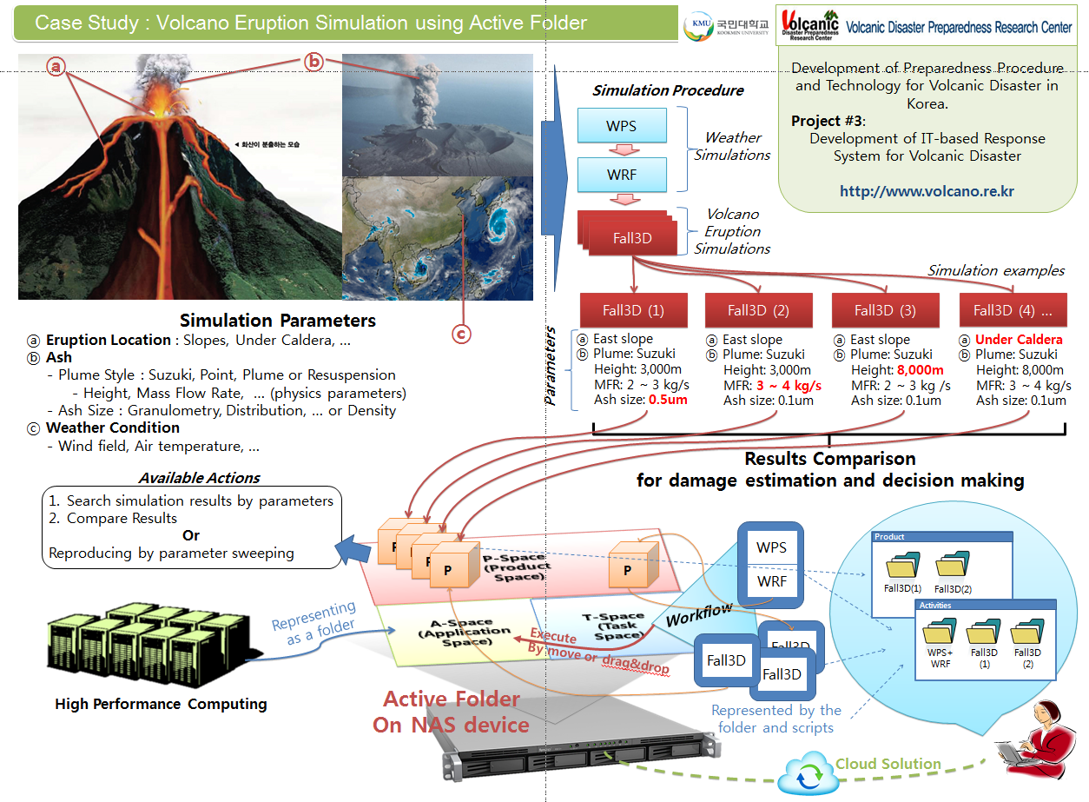
Case Study : Volcano Eruption Simulation using Active Folder

Slide 8
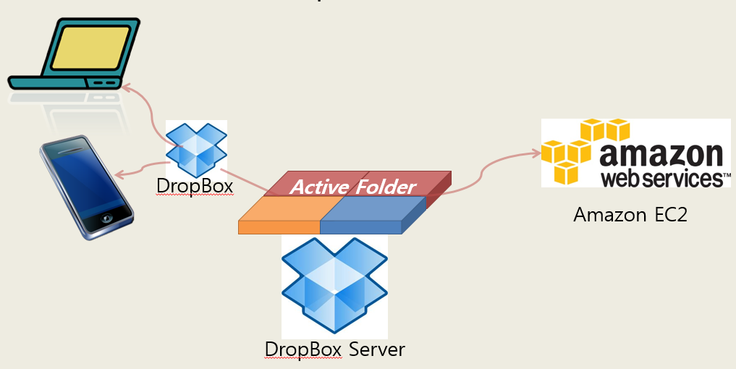
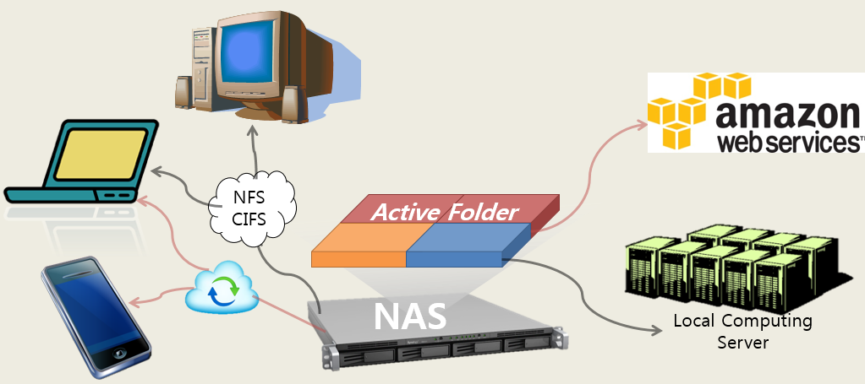
Short history of Active Folder
Active Folder on DropBox+EC2
Cost & Performance Problem with very large files
at PRAGMA 24
http://www.youtube.com/watch?v=vXTh3tCHEPE
Active Folder on NAS
NAS(Network Attached Storage)
Large Volume Storage
Network File System ( NFS, SMB/CIFS, AFP … )
Most vendors support Cloud solution like DropBox
at PRAGMA 25

Slide 9




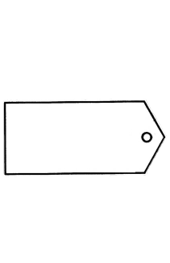


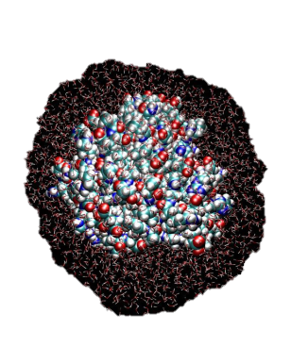




Active Folder Features 1:
Computing by manipulating files or folders, which makes only files visible by hiding correlation of computing method, parameters, result files and computing resources
NAMD
AMBER
CHARMM
SSH
GAUSSIAN
A-SPACE
ssh.server.com
Temperature
273K
Server
ActiveFolder . . . ...
CHARMM
Simulation
Spin
1000
Everything is
Applications
Script
File & Folder
T-SPACE
CHARMM
Activity
Drag & Drop
Execution
Planning
Notes:
Image from
http://missionemilano.blogspot.kr/
http://www.veryicon.com/
Charmm.org
http://www.clker.com/
http://upload.wikimedia.org/

Slide 10


Relationship
PROVIDED / USED
Active Folder Features 2:
Keep the way of computing methods and parameters with result files silently
History Board
Created by CHARMM Activity
From ssh.server.com
At 2014.m.d
StageOut : 2014.m.d 12:30
StageOut : 2014.m.d 13:02
How to create this product?
Temperature
273K
Data Provenance
Spin
1000
Product
ActiveFolder . . . ...
CHARMM
Simulation
Script
P-SPACE
Product
Products

Slide 11
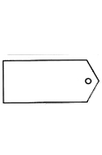
Parameters
ActiveFolder . . . ...
CHARMM
Simulation
Parameters
Parameters
Parameters
Data Provenance
Parameters
Script
Searching
Temperature
300K
Temperature
293K
Parameters
Parameters
Parameters
Active Folder Features 3:
Searching result files and other corelated ones

Slide 12


Active Folder Features 4:
Computing by manipulating files or folders, Re-generating either the same or similar ones by existing result files
Using data provenance
Reproduction
Execution
Extracting
ActiveFolder . . . ...
CHARMM
Simulation
Temperature
293K
Parameters
Parameters
Parameters
Script
Parameters
Parameters
Parameters
Parameters
Parameters
Parameters
T-SPACE
CHARMM
Applying
New Methods/Parameters
Activity

Slide 13

A-SPACE
ssh.server.com
Active Folder Features 5:
Returns computing results
by progressive synchronization
without connecting computing server
Server
SSH
CHARMM
Between server and your active folder
Data Synchronization
Charmm.dcd file created
StageOut : 2014.m.d 12:30
Charmm.dcd file modified
StageOut : 2014.m.d 1:13
Timeline
stdout.afsx.log file created
StageOut : 2014.m.d 1:14
Products
stdout.afsx.log file modified
StageOut : 2014.m.d 1:15
Automatic Stage-Out to ActiveFolder
Incremental update.

Slide 14




ActiveFolder
P-SPACE
Smartphone
T-SPACE
CHARMM
Products
A-SPACE
Microsoft
Windows
ssh.server.com
Activity
Linux
SAMBA
Server
NFS
MacOSX
FTP
Cloud
Storage
Your Desktop, Laptop or Mobile
Support Legacy File Service
File Navigator
Data Delivery
Apps
Activities
Products
Active Folder Features 6:
Support various file service such as NFS, Samba(CIFS) and FTP
Open this files
by your favorite softwares

Slide 15
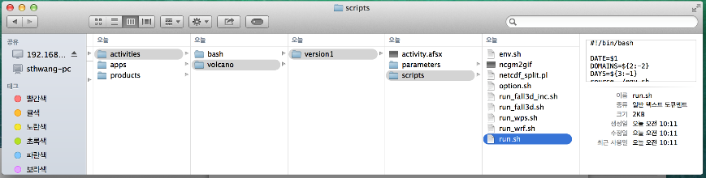


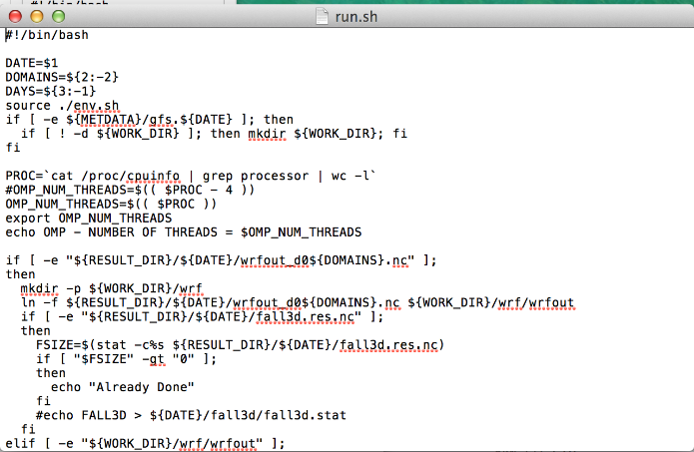
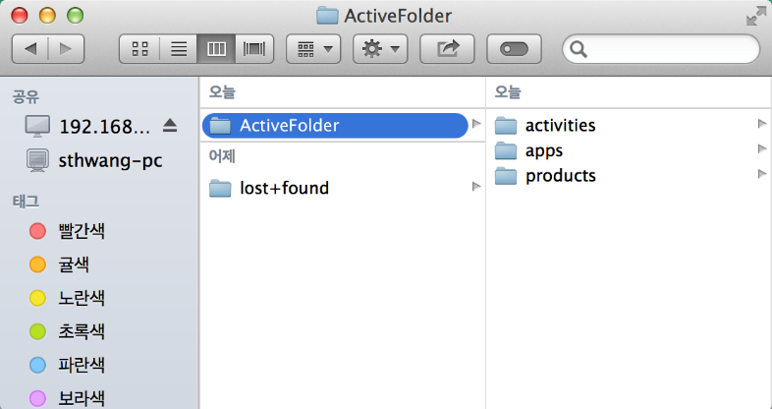
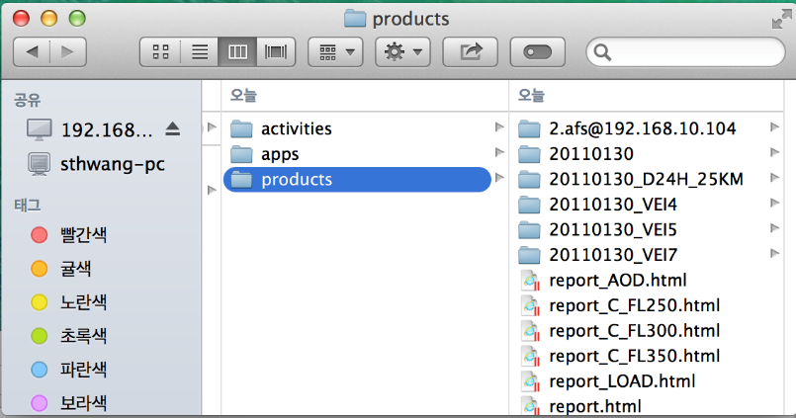
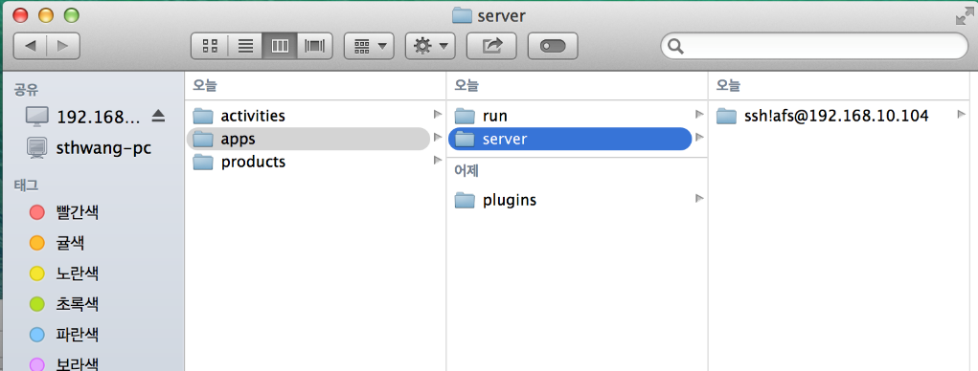

Active Folder: Overall View
Searching and Analysis
T-SPACE
CHARMM
Activity
ActiveFolder
P-SPACE
Products
A-SPACE
ssh.server.com
Servers

Slide 16
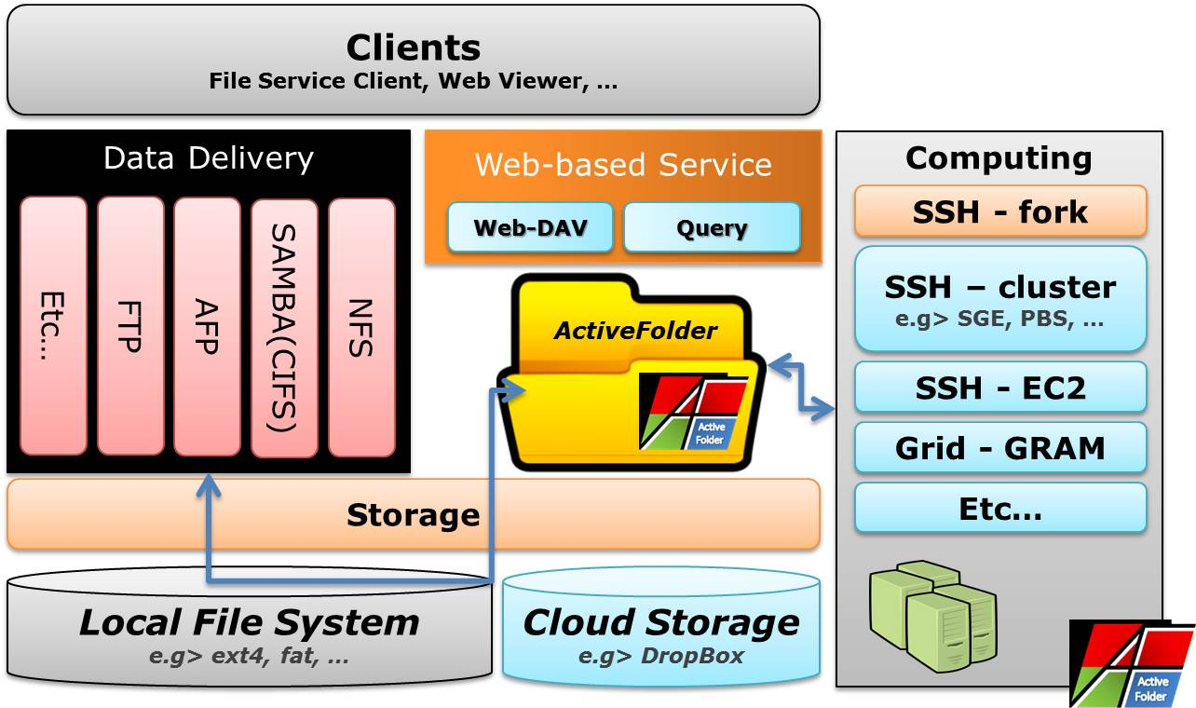
Active Folder: Software Architecture

Slide 17

Usage of Active Folder
Good for managing & sharing data in a small group of Lab
For Power-users using legacy SW in their own computing environment (without GUI sometimes)
ActiveFolder
Computing
Environment
(Large scale service)
Satellite Service
ActiveFolder
Satellite Service
* Private Space
- File Management
- Private Archiving
* For Power-User
ActiveFolder
Satellite Service

Slide 18
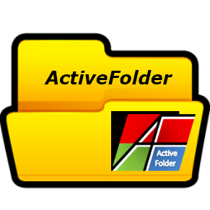
Active Folder Site
Active Folder is released
http://www.activefolder.org
Downloads
Binary file for general installation(Synology(NAS) tested)
RPM for Redhat 6/CentOS 6
Coming soon
Product searching interface
Synology packaging for NAS
Integrated using NAS and DropBox together
Attention! .org only,
not .com

Slide 19
Thank you!
Questions?

